Slide 1
Autonomous Flag Finder
Burnout Squad
Jeremiah McCutcheon: Project Manager
David Koblah: Hardware Design
Michael Bates: Software Design

Slide 2
System Description
This system is an autonomous robot designed to locate, identify and retrieve flags inside a room or maze.
It will utilize a camera and proximity sensors to navigate its environment.
The camera will wirelessly communicate with a computer in order to identify flags and retrieve them.
A microcontroller will control the movement of the tank, proximity sensors and servo motors to rotate the camera or retrieve the flags.
David Koblah

Slide 3
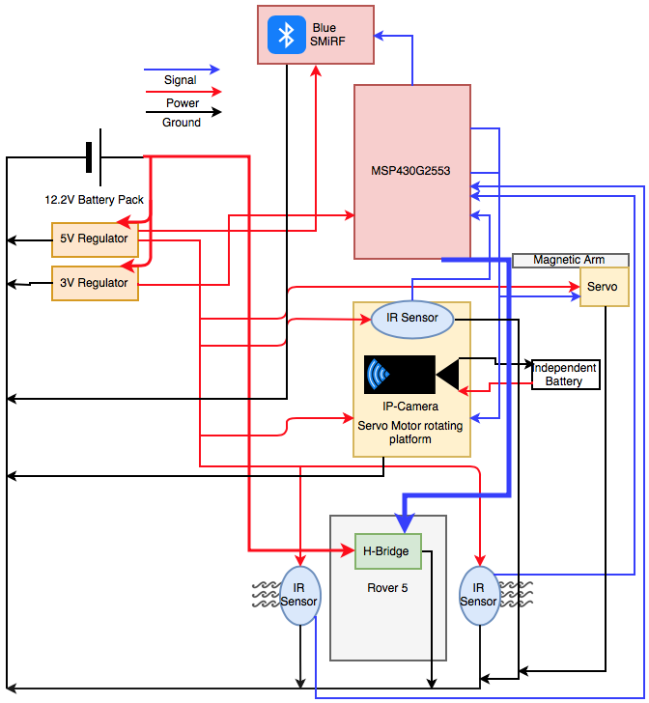
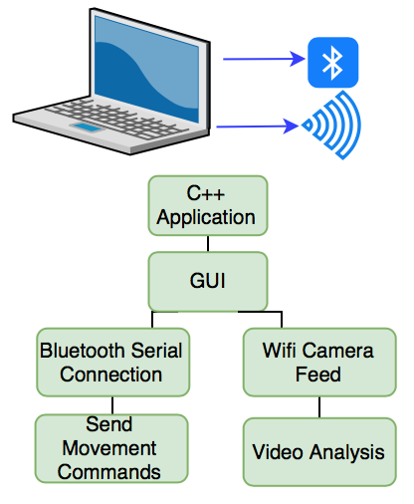
System Diagram
Jeremiah McCutcheon

Slide 4
Division of labor
Jeremiah: Bluetooth serial communication on Mac, Tank movement
David: H-Bridge Implementation, Blue SMiRF receiving communication
Michael: Movement commands, UART Interrupts, IR sensor implementation
Jeremiah McCutcheon

Slide 5
Safety Concerns
Over the last week, we have had to use appropriate voltages for the BlueSmirf and the MSP430 Launchpad.
We needed to be careful with the 9.6V rated battery for the Rover, since it is known to catch fire or explode if it is not properly charged and connected.
David Koblah

Slide 6
Last Week’s Deliverables
Jeremiah McCutcheon
Acquire IP camera and start configuring communication ❌
Begin writing image processing code ❌
David Koblah
Begin writing code for UART Bluetooth communication ✅
Research integrating Bluetooth and IP communication into one UI ✅
Michael Bates
Write skeleton code for MSP Board ✅
Integrate sensors into system ✅
Michael Bates

Slide 7
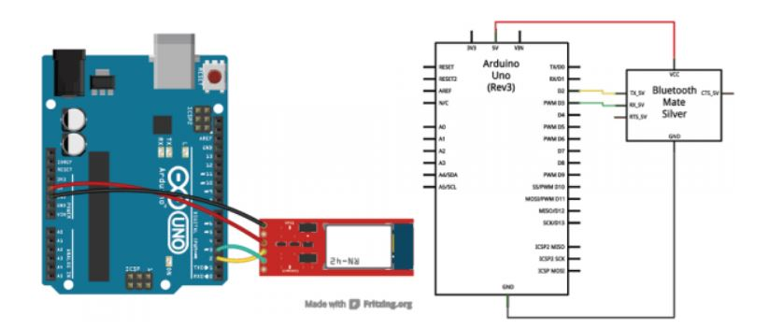
Bluetooth-UART Initialization
The Arduino is the best device for Initialization with the Smirf. Serial communication is easier to establish, and was recommended by the manufacturer (Sparkfun). [1]
David Koblah
Sparkfun BlueSMiRF [1]

Slide 8
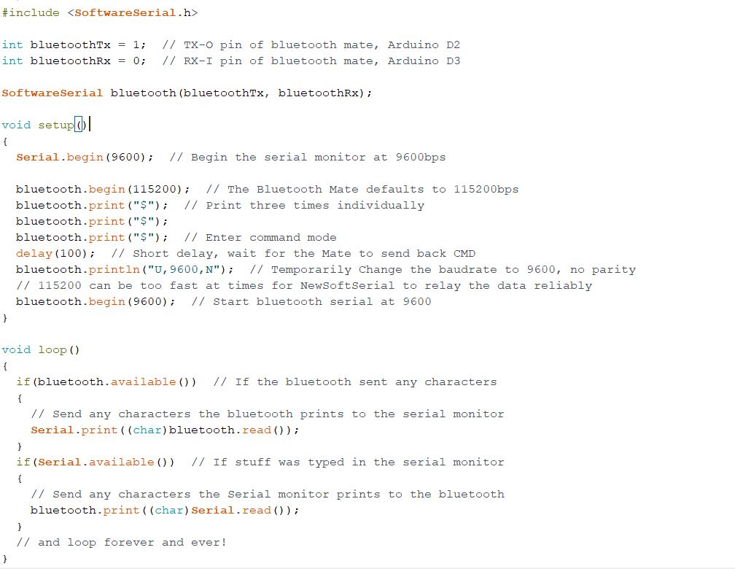
Serial Communication Initialization Code
David Koblah
Sparkfun BlueSMiRF [1]

Slide 9
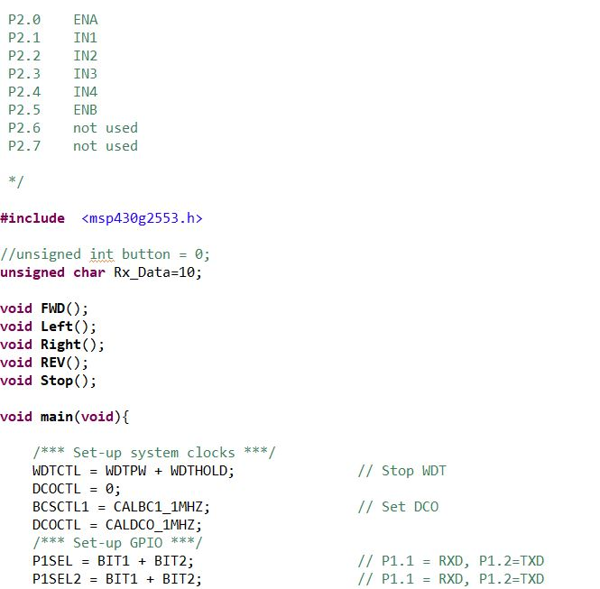
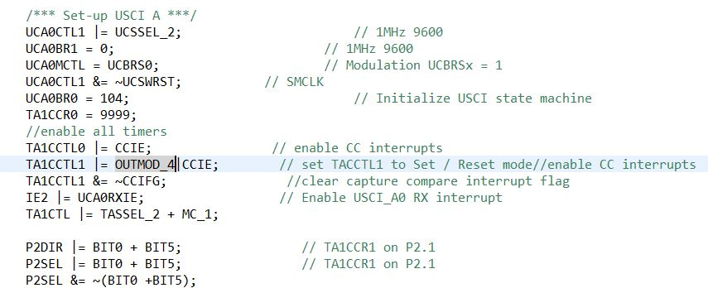
Bluetooth Movement Test for Rover
David Koblah

Slide 10
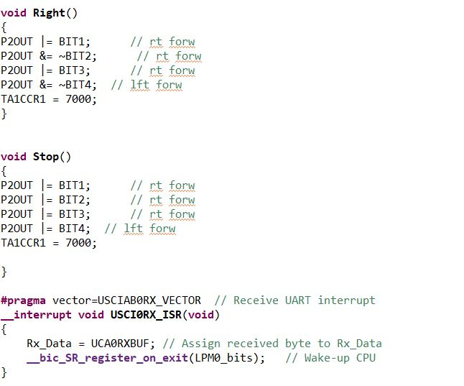
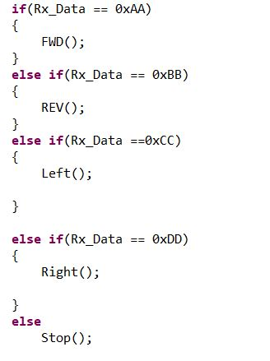
Bluetooth Movement Test for Rover
David Koblah

Slide 11
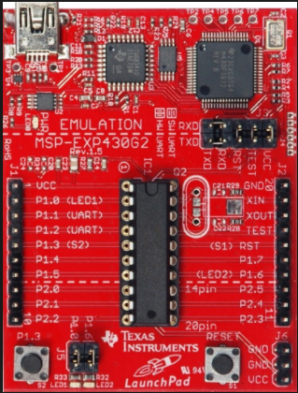
MSP430G2553
Launchpad [2]
Michael Bates

Slide 12
MSP430G2553 over MSP430F5529
Removable MCU IC
Can use launchpad for testing during the design and implementation phases
Can transport to PCB for verification phase
Sufficient GPIO Pins
We only need 8 GPIO Pins: 6 for H-Bridge and 2 for IR sensors
Michael Bates

Slide 13
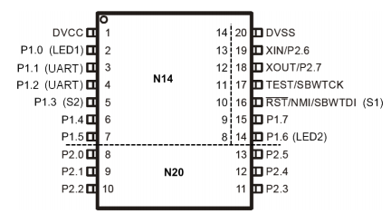
MSP430G2553 Pinout
Extras
IR Sensors
Rover 5
Pinout Scheme [3]
Michael Bates

Slide 14
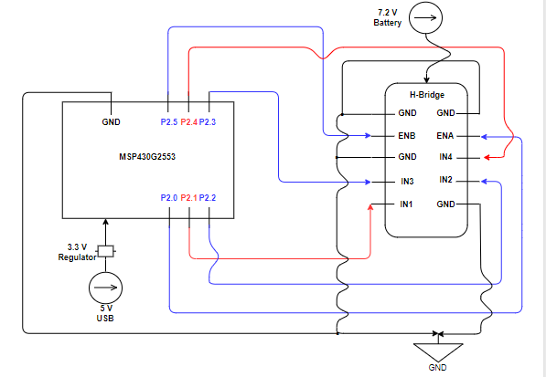
H-Bridge Interface
12 V
Michael Bates

Slide 15
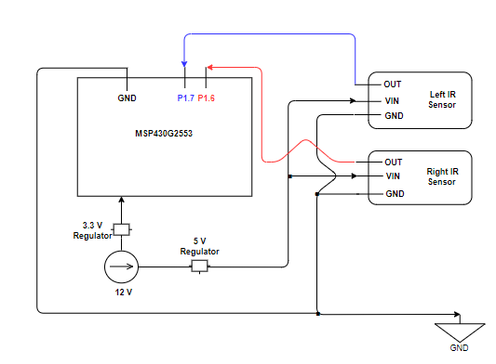
IR Sensor Interface
Michael Bates

Slide 16
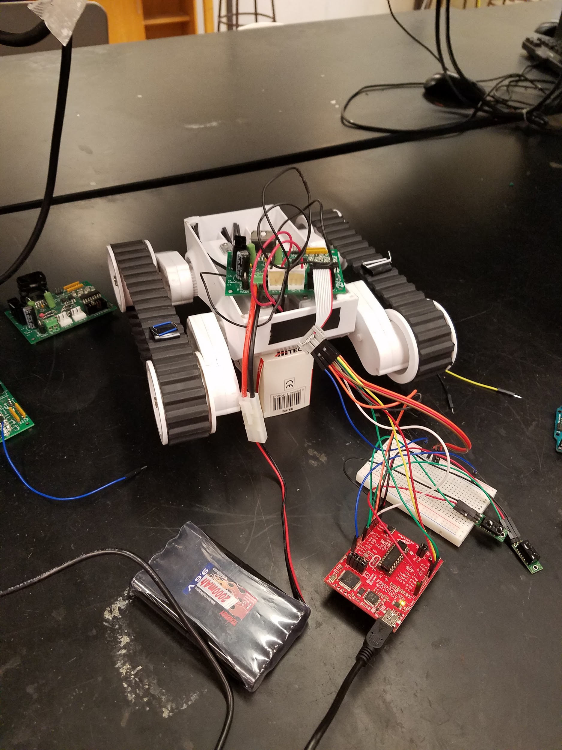
Rover 5 Interface Testing
Michael Bates

Slide 17
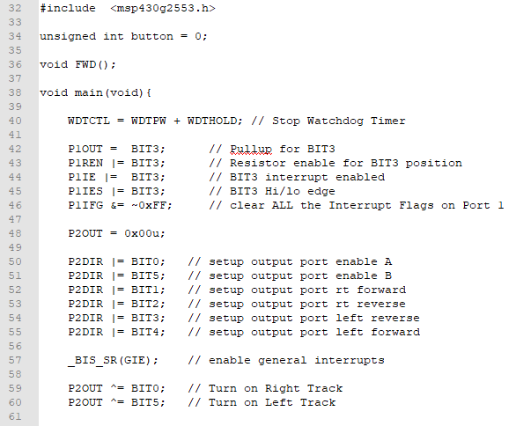
Movement Test Code with Push Button
Michael Bates

Slide 18
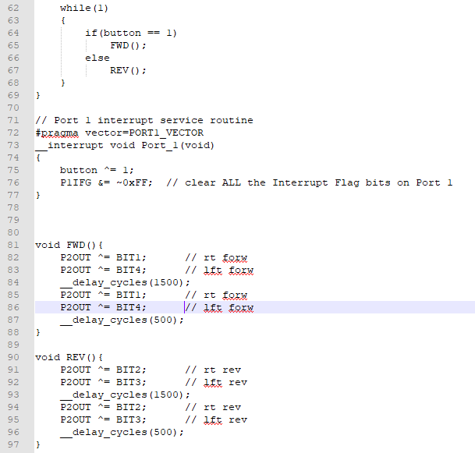
Movement Test Code with Push Button Cont.
Michael Bates

Slide 19
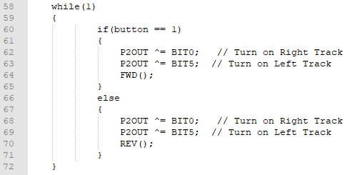
Movement Test Code with IR Sensor
Michael Bates

Slide 20
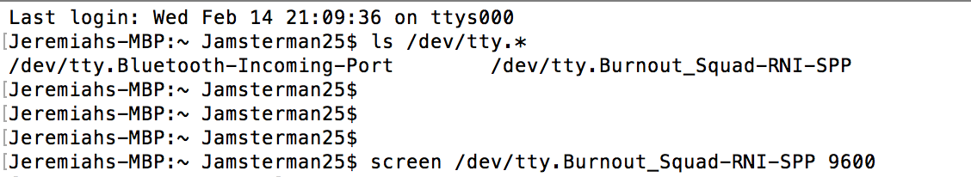
Accessing Serial ports on Mac
Jeremiah McCutcheon
[4] StackOverflow: Sr.Richie

Slide 21
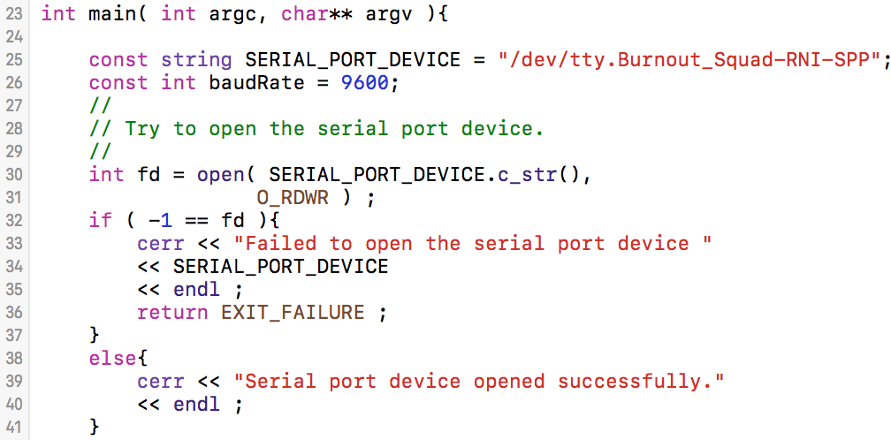
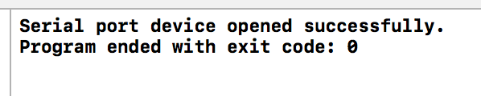
C++ Bluetooth Serial Communication
Console: successful connection
Jeremiah McCutcheon
[5] SourceForge: Crayzeewulf & Wedesoft

Slide 22
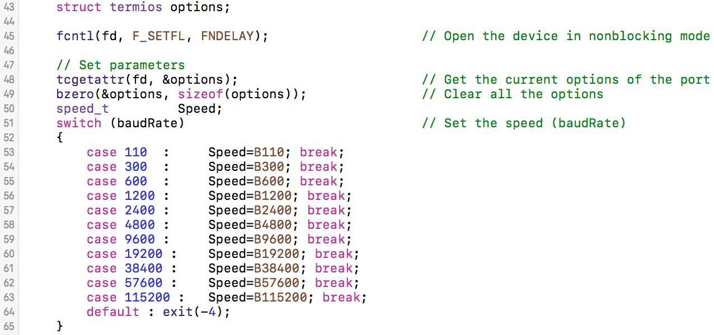
Establishing Serial Settings
Jeremiah McCutcheon
[6] StackOverflow: Ajay

Slide 23
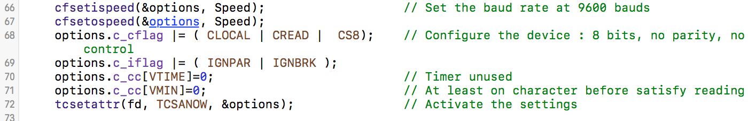
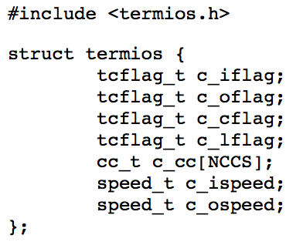
Establishing Serial Settings Continued
Terminal inuput control
Terminal output control
Hardware control
Echo / additional signals
Baud rate controls
Jeremiah McCutcheon
[6] StackOverflow: Ajay, [7] MKSSoftware.com

Slide 24

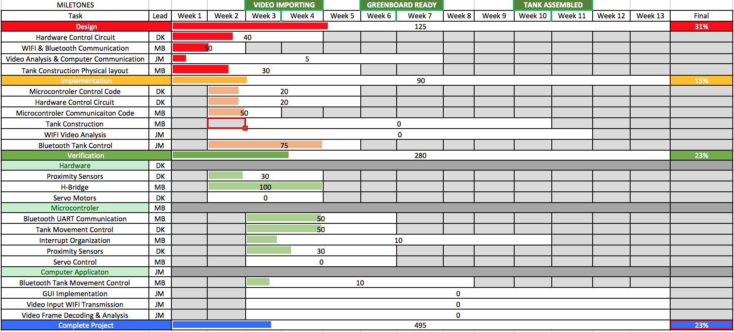
Gantt Chart
Jeremiah McCutcheon

Slide 25

Budget
Michael Bates

Slide 26
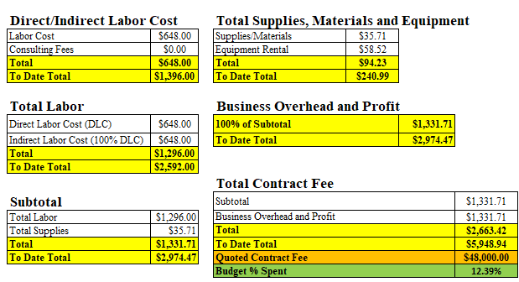
Budget Continued
Michael Bates

Slide 27
Next Week’s Deliverables
Jeremiah
Establish full manual control of rover via bluetooth C++ App
Begin IP camera integration
Prototype user interface
David
Integrate Bluetooth control into User Interface
Assist with writing code for image processing
Prepare motor arm code and hardware
Michael
Liaison with lab tutor to install router for IP camera
Complete IR Sensor interface
Research/Order Flags
Complete Budget Request
David Koblah

Slide 28
References
[1] Sparkfun, Sparkfun Bluetooth Modem-BlueSMiRF Silver https://learn.sparkfun.com/tutorials/using-the-bluesmirf
[2] Texas Instruments User’s Guide, MSP430G2553 Launchpad Development Kit, http://www.ti.com/tool/MSP-EXP430G2
[3] MSP-EXP430G2553 User’s Guide, Device PinOut, page 14, http://www.ti.com/lit/ug/slau318g/slau318g.pdf
[4] StackOverflow: How to find the serial port number on Mac OS X: Sr.Richie, https://stackoverflow.com/questions/12254378/how-to-find-the-serial-port-number-on-mac-os-x
[5] SourceForge: Serial Port Programming in C++, https://sourceforge.net/p/libserial/bugs/4/
[6] StackOverflow: Open a serial port with arduino using C++ with Xcode on mac: Ajay, https://stackoverflow.com/questions/27609972/open-a-serial-port-with-arduino-using-c-with-xcode-on-mac

Slide 29
References Continued
[7] The Termios Struct, https://www.mkssoftware.com/docs/man5/struct_termios.5.asp

Slide 30
Questions?

